Slide 1

BLUE TEAM

Slide 2
Table of Contents
This document contains the following resources:
Alerts Implemented
Hardening
Implementing Patches

Slide 3
Alerts Implemented

Slide 4
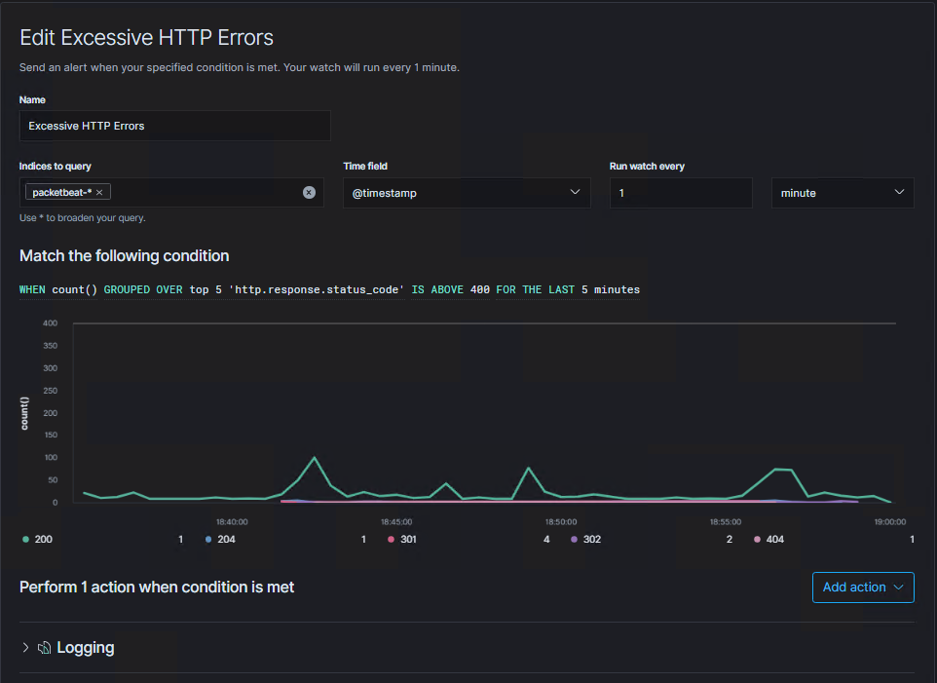
Excessive HTTP Errors
Metric: Number of HTTP requests
Threshold: More than 5 HTTP requests with status codes of 400 or higher within 5 minutes
Vulnerability Mitigated: This will warn of us of brute force attacks attempted against passwords or usernames on the WordPress site. It will also alert us to attempts to map the directories of our website.
Reliability: High. Legitimate users should not generate so many errors in so short a time.

Slide 5
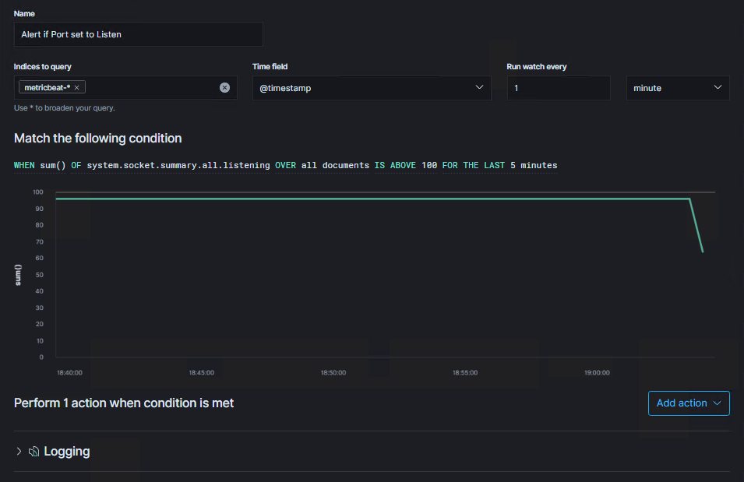
HTTP Request Size Monitor
Metric: Size (in bytes) of HTTP requests
Threshold: When size of HTTP requests for the last minute exceeds 3500
Vulnerability Mitigated: Will warn of us of attempts to upload or download larger files than they should, like copying our MySQL database or uploading an exploit payload, to the WordPress site.
Reliability: Medium. Some legitimate traffic may approach this threshold, but not often enough to justify raising the threshold.

Slide 6
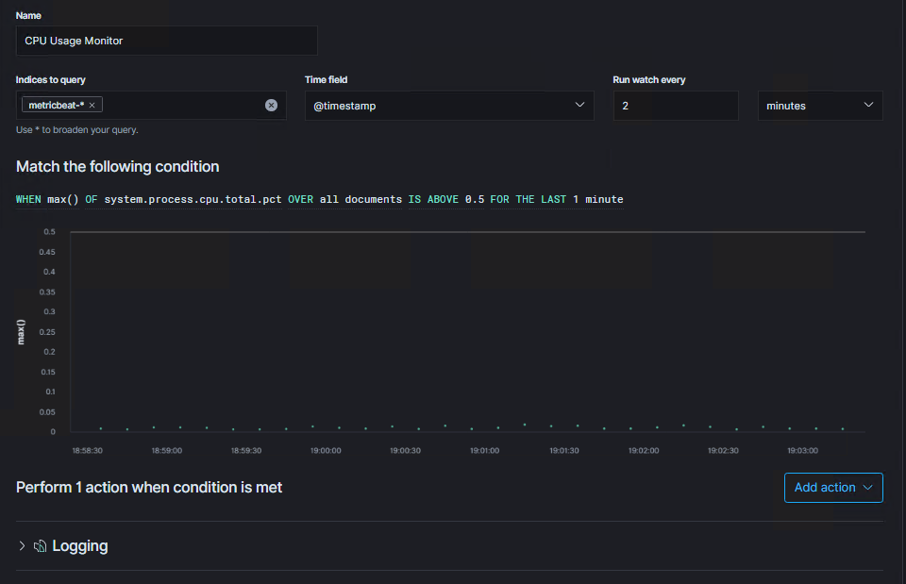

CPU Usage Monitor
Metric: Percentage of total CPU capacity used by processes on the system.
Threshold: When percentage of CPU capacity being used exceeds 50% in a five-minute period.
Vulnerability Mitigated: This will warn us any time a large amount of the system’s capacity is used, like it would be during a Denial of Service (DoS) attack or if the system is trying to process large numbers of requests coming to the system in a short period of time, like during a Brute Force attack.
Reliability: High, if the hardware has adequate CPU headroom legitimate activity should not frequently tax the system to the extent of our threshold.

Slide 7
Hardening

Slide 8
Weak Passwords on Target 1
Patch: Implement stronger password policy by editing the common-password file located in /etc/pam.d/commonpassword
Why It Works: During our penetration test, much of the access we were able to gain, including root access, was made significantly more attainable because of the weak passwords on user accounts and the SQL database. By implementing a strong but reasonable password policy we can help users and administrators to choose passwords that are difficult for automated Brute Force tools to guess in short amounts of time.

Slide 9
rcpbind on Target 1
Patch: Update to latest versions of both rpcbind and libtirpc, download additional packages if necessary. Unless required, consider disabling or removing the service.
Why It Works: rpcbind is a service that helps other services find appropriate sockets to communicate. This vulnerability allows an attacker to allocate up to 4 gigabytes of memory, and that memory isn’t freed unless the process crashes or the service is halted or restarted. This vulnerability has been patched and updating should remediate the issue.

Slide 10
NetBIOS (Samba) on Target 1
Patch: Update to the latest version of Samba, then check for updates regularly.
Why It Works: Older versions of the service are vulnerable to several exploits, by staying up to date we can avoid those and future vulnerabilities as fast as Samba’s update team can fix them.

